Slide 1
Adaptive Random Forest with Resampling for Imbalanced data Streams Data Mining Lab SS2020 22.07.2020
Kush Varma (kush.varma@stud.uni-hannover.de)

Slide 2

Outline
Introduction
Problem Statement
Class Imbalance
Solution: Adaptive Random Forest with Resampling
ARF_{RE} Algorithm
Moa & scikit-multiflow
Dataset
Performance Metrics
Overall Results
Conclusion

Slide 3
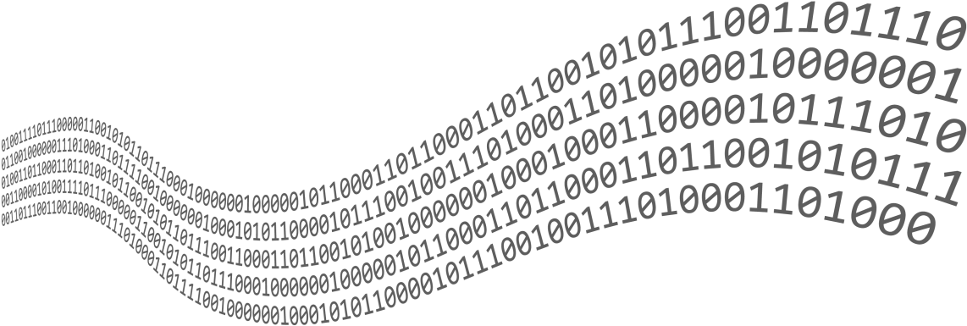
Introduction
Large volume of continuous Real time Streams
Traditional ML algorithm works in batch with fixed data set
Traditional algorithm can not be applied for streams
Algorithms which solves these issue
Online Bagging
Adaptive Random Forest
Imbalance datasets
Imbalance datasets in streams
ARF with Resampling

Slide 4

Problem Statement
Classification problem involving imbalanced data, in context to data streams
Traditional classification algorithms focus on Representative instances, hence neglecting minority instances
In streams, problem become more evident, reducing observation of minority instances.
Delay in discovery of existing patterns
Also faces concept drifts

Slide 5

Class Imbalance
Imbalanced data is characterized by having more instances belonging to one class than others.
Minority class instances rarely occurs.
Rare, undiscovered or ignored classification.
How to deal with class imbalance?
Traditionally it can be solved using:
Sampling
Ensembles
Cost-sensitive methods
For streaming: Hybrid solution: ARF with Resampling: ARF_{RE}

Slide 6

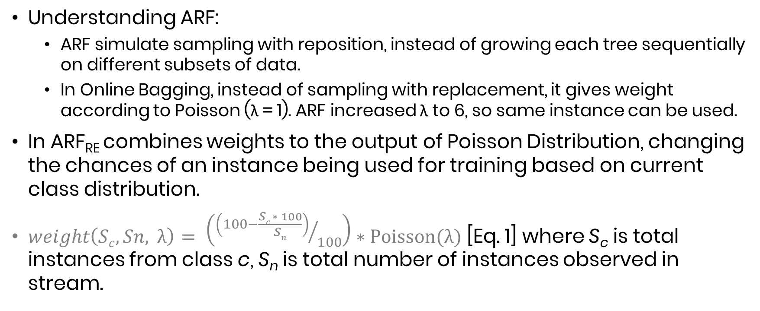
Solution: Adaptive Random Forest with Resampling (ARF_{RE})
Understanding ARF:
ARF simulate sampling with reposition, instead of growing each tree sequentially on different subsets of data.
In Online Bagging, instead of sampling with replacement, it gives weight according to Poisson (λ = 1). ARF increased λ to 6, so same instance can be used.
In ARF_{RE} combines weights to the output of Poisson Distribution, changing the chances of an instance being used for training based on current class distribution.
$weight\left(Sc, Sn, λ\right)= \left({\left(100−\frac{Sc ∗ 100}{Sn}\right)}/{100}\right)∗Poisson(λ)$ [Eq. 1] where S_{c} is total instances from class c, S_{n} is total number of instances observed in stream.

Slide 7
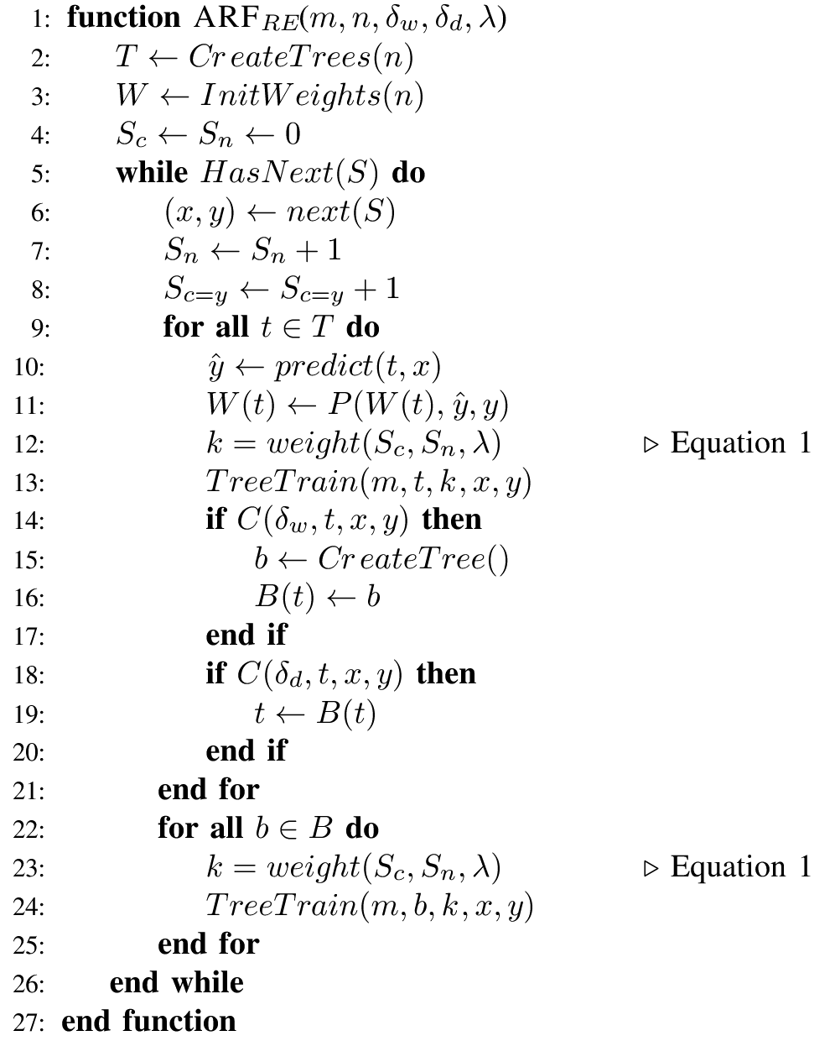

ARF_{RE} Algorithm
ARF with resampling.
Symbols: m: maximum features evaluated per split
n: total number of trees
δ_{w}: warning threshold
δ_{d}: drift threshold
c(·): change detection method
S: Data stream
B: Set of background trees
W(t): Tree t weight
P(·): Learning performance estimation function
S_{n}: Current instance counter
S_{c}: Number of occurrences of class label c
λ: Expected value and variation of a Poisson distribution

Slide 8
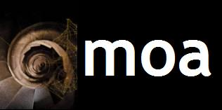

MOA & scikit-multiflow
Moa: Massive Online Analysis
Java based ML tool for stream
ML Algo: classification, regression, clustering, outlier detection, concept drift detection and recommender systems and tools for evaluation.
Experiments in the paper were performed on MOA with ARF_{RE} extension.
Scikit-multiflow
Inspired by MOA
Inspired by scikit-learn
multi-output/multi-label and stream data.

Slide 9

Datasets
Considering 7 data sets, 6 real and 1 synthetic.
AIR: Airline dataset, task is to predict which flights are going to be delayed based on information on the scheduled departure.
ELEC: Electricity dataset, task is to predict whether the electricity prices are going up or down relative to moving avg of last 24h.
GMSC: Goal is to predict whether a loan should be allowed.
COVTYPE: A forest cover type for 30X30 m cell, where each cover types represented by one of the seven classes
PIMA: It is a by product of a longitudinal study of health in the Pima Indian population
WEATHER: Weather dataset, which is not from the paper.
SEA Generator: Produces data streams with three continuous features.

Slide 10
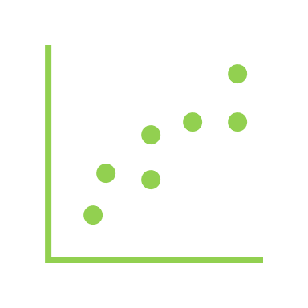
Performance Metrics
Prequential evaluation(PE) with the recall
test-then-train approach.
best for estimating error on data streams.
Faster response for detecting drifts
Recall is best metric to access performance when dealing with imbalanced dataset.
Macro Avg of Recall(balanced Average), CPU time to train and update the model and g-mean.
Testing ARF_{RE} with ARF also with state-of-the-art ensembles classifier like: Leveraging bagging, online bagging, learnNSE and Online accuracy update ensemble.

Slide 11

Overall Result GMSC, ELEC, AIR
My findings
Paper findings
GMSC | recall [0] | recall[1] | CPU seconds | g-mean | Balanced-Accuracy |  | recall [0] | recall[1] | CPU seconds | g-mean | Balanced-accuracy
ARF_RE | 89.13 | 65 | 8.43 | 76.11471605 | 77.065 |  | 90.05 | 56.37 | 14.51 | 71.24688414 | 73.21
ARF | 99.13 | 18.75 | 178 | 43.11249819 | 58.94 |  | 99.27 | 12.66 | 49 | 35.4507856 | 55.965
L NSE | 77.92 | 53.731 | 23.05 | 64.70486473 | 65.8255 |  | 76.57 | 51.83 | 70.04 | 62.99700866 | 64.2
LB | 99.23 | 18.75 | 8.61 | 43.13423814 | 58.99 |  | 99.47 | 10.38 | 16.86 | 32.13251624 | 54.925
OZA | 99.67 | 6.25 | 2.77 | 24.95871591 | 52.96 |  | 99.66 | 7.58 | 5.59 | 27.48495588 | 53.62
OAUE | 99.02 | 12.5 | 6.19 | 35.18167136 | 55.76 |  | 99.64 | 7.5 | 11.76 | 27.3367884 | 53.57
ELEC | recall [0] | recall[1] | CPU seconds | g-mean | Balanced-Accuracy |  | recall [0] | recall[1] | CPU seconds | g-mean | Balanced-accuracy
ARF_RE | 94.86 | 89.86 | 4.55 | 92.32615881 | 92.36 |  | 86.81 | 91.44 | 9.54 | 89.09492915 | 89.125
ARF | 95.93 | 90.43 | 64.12 | 93.1394111 | 93.18 |  | 85.41 | 92.13 | 11.08 | 88.70638816 | 88.77
L NSE | 68.09 | 74.48 | 2.17 | 71.21336391 | 71.285 |  | 70.15 | 71.74 | 6.37 | 70.94054553 | 70.945
LB | 93.36 | 90.99 | 3.22 | 92.16738252 | 92.175 |  | 85.67 | 92.74 | 7.08 | 89.1349303 | 89.205
OZA | 87.36 | 88.74 | 0.92 | 88.04729638 | 88.05 |  | 76.7 | 86.64 | 1.91 | 81.51863591 | 81.67
OAUE | 93.14 | 90.24 | 1.89 | 91.67853402 | 91.69 |  | 83.91 | 90.56 | 3.72 | 87.17161006 | 87.235
AIR | recall [0] | recall[1] | CPU seconds | g-mean | Balanced-Accuracy |  | recall [0] | recall[1] | CPU seconds | g-mean | Balanced-accuracy
ARF_RE | 55.28 | 65.48 | 271 | 60.16422857 | 60.38 |  | 67.93 | 56.05 | 396.76 | 61.70475265 | 61.99
ARF | 65.33 | 61.93 | 2495 | 63.60728653 | 63.63 |  | 71.34 | 51.88 | 544.46 | 60.83682437 | 61.61
L NSE | 56.49 | 59.1 | 746 | 57.7802648 | 57.795 |  | 67.94 | 55.4 | 985.42 | 61.35043602 | 61.67
LB | 59.44 | 58.39 | 311 | 58.91266078 | 58.915 |  | 74.73 | 48.72 | 502.04 | 60.33941995 | 61.725
OZA | 74 | 48.69 | 47.19 | 60.02549458 | 61.345 |  | 84.09 | 41.07 | 67.95 | 58.76713622 | 62.58
OAUE | 67.41 | 62.17 | 192.3 | 64.7370041 | 64.79 |  | 81.37 | 50.27 | 295.78 | 63.9567815 | 65.82
Adaptive Random Forest with Resampling (ARF_RE)
Adaptive Random Forest(ARF)
Learn NSE (L NSE)
Leveraging bagging(LB)
Online bagging(OZA)
Online accuracy update ensemble(OAUE)

Slide 12
Overall Result COVTYPE, SEA, PIMA
My findings
Paper findings
COVTYPE | recall [2] | recall[5] | CPU seconds | g-mean | Balanced-Accuracy |  | recall [2] | recall[4] | CPU seconds | g-mean | Balanced-accuracy
ARF_RE | 99.65 | 93.93 | 176 | 96.74773641 | 96.79 |  | 95.44 | 82.58 | 289.22 | 88.77744759 | 89.01
ARF | 99.3 | 93.18 | 1894 | 96.19134057 | 96.24 |  | 96.72 | 78.12 | 448.18 | 86.92391155 | 87.42
L NSE | 65.32 | 96.96 | 2281 | 79.58283232 | 81.14 |  | 71.18 | 30.73 | 4000.93 | 46.76923561 | 50.955
LB | 98.38 | 94.69 | 111 | 96.51736735 | 96.535 |  | 94.17 | 75.94 | 197.19 | 84.56518078 | 85.055
OZA | 94.81 | 82.57 | 42.5 | 88.47859459 | 88.69 |  | 90.87 | 42.59 | 79.86 | 62.21055618 | 66.73
OAUE | 96.88 | 93.939 | 102 | 95.39816728 | 95.4095 |  | 92.46 | 76.52 | 163.56 | 84.11325223 | 84.49
SEA | recall [0] | recall[1] | CPU seconds | g-mean | Balanced-Accuracy |  | recall [0] | recall[1] | CPU seconds | g-mean | Balanced-accuracy
ARF_RE | 78.9 | 94.8 | 108.23 | 86.48537449 | 86.85 |  | 80.68 | 94.34 | 173.55 | 87.24305818 | 87.51
ARF | OOM | OOM |  | - |  |  | 80.28 | 94.63 | 246.47 | 87.16017669 | 87.455
L NSE | 71.38 | 93.27 | 588 | 81.59419465 | 82.325 |  | 72.91 | 93.22 | 1260.47 | 82.44192016 | 83.065
LB | 80.34 | 95.56 | 39.41 | 87.62014837 | 87.95 |  | 80.61 | 94.93 | 74.84 | 87.47746738 | 87.77
OZA | 80.63 | 95.56 | 13.25 | 87.77814534 | 88.095 |  | 80.36 | 94.8 | 21.8 | 87.28188816 | 87.58
OAUE | 80.05 | 95.25 | 26.7 | 87.31988605 | 87.65 |  | 80.57 | 94.85 | 46.65 | 87.41890242 | 87.71
PIMA | recall [0] | recall[1] | CPU seconds | g-mean | Balanced-Accuracy |  | recall [0] | recall[1] | CPU seconds | g-mean | Balanced-accuracy
ARF_RE | 79.6 | 61.94 | 0.078 | 70.216978 | 70.77 |  | 81 | 66.04 | 0.34 | 73.13849875 | 73.52
ARF | 87.2 | 49.25 | 1.09 | 65.53319769 | 68.225 |  | 87.6 | 54.48 | 1.18 | 69.08290671 | 71.04
L NSE | 87 | 36.56 | 0 | 56.3978723 | 61.78 |  | 87 | 36.57 | 0.08 | 56.40558483 | 61.785
LB | 83.6 | 53.73 | 0.03 | 67.02110115 | 68.665 |  | 83.6 | 53.73 | 0.2 | 67.02110115 | 68.665
OZA | 78.2 | 59.32 | 0.015 | 68.10891278 | 68.76 |  | 78.2 | 59.33 | 0.14 | 68.11465334 | 68.765
OAUE | 94.8 | 19.4 | 0 | 42.8849624 | 57.1 |  | 94.8 | 19.4 | 0.05 | 42.8849624 | 57.1
Adaptive Random Forest with Resampling (ARF_RE)
Adaptive Random Forest(ARF)
Learn NSE (L NSE)
Leveraging bagging(LB)
Online bagging(OZA)
Online accuracy update ensemble(OAUE)

Slide 13
Overall Result comparing ARF_{RE} FOR GMSC, ELEC, AIR, COVTYPE, SEA, PIMA

Slide 14
Overall Result WEATHER
My findings
Adaptive Random Forest with Resampling (ARF_RE)
Adaptive Random Forest(ARF)
Learn NSE (L NSE)
Leveraging bagging(LB)
Online bagging(OZA)
Online accuracy update ensemble(OAUE)
WEATHER | recall [0] | recall[1] | CPU seconds | g-mean | Balanced-Accuracy
ARF_RE | 56.46 | 85.46 | 1.65 | 69.46273533 | 70.96
ARF | 81.54 | 8.3 | 39.98 | 26.01503411 | 44.92
L NSE | 65.93 | 68.57 | 0.5 | 67.23704411 | 67.25
LB | 73.34 | 72.95 | 1.29 | 73.14474007 | 73.145
OZA | 70.5 | 65.84 | 0.37 | 68.13016953 | 68.17
OAUE | 74.13 | 71.584 | 0.718 | 72.84587785 | 72.857

Slide 15
Overall Result Different λ
 |  | λ=7
 | Recall |  | CPU
ARF_RE | 0 | 1 | Seconds | g-mean | balanced-accuracy
GMSC | 86.3 | 63.74 | 11.84 | 74.167122 | 75.02
ELEC | 95.5 | 89.11 | 6.28 | 92.249688 | 92.305
AIR | 57.01 | 61.7 | 281.56 | 59.308659 | 59.355
COVTYPE | 98.61 | 92.42 | 180.08 | 95.464843 | 95.515
SEA | 80.63 | 94.64 | 121.89 | 87.354583 | 87.635
PIMA | 78.2 | 64.18 | 0.12 | 70.844026 | 71.19
WEATHER | 54.73 | 84.97 | 2.39 | 68.193901 | 69.85
 |  | λ=8
 | Recall |  | CPU
ARF_RE | 0 | 1 | Seconds | g-mean | balanced-accuracy
GMSC | 84.78 | 71.25 | 18.09 | 77.721136 | 78.015
ELEC | 96.35 | 88.55 | 6.78 | 92.367703 | 92.45
AIR | 55.11 | 60.75 | 301.12 | 57.861321 | 57.93
COVTYPE | 99.53 | 91.66 | 190.81 | 95.513977 | 95.595
SEA | 80.63 | 94.64 | 134.59 | 87.354583 | 87.635
PIMA | 81.39 | 58.2 | 0.14 | 68.825126 | 69.795
WEATHER | 58.99 | 81.96 | 2.61 | 69.532873 | 70.475
 |  | λ=9
 | Recall |  | CPU
ARF_RE | 0 | 1 | Seconds | g-mean | balanced-accuracy
GMSC | 86.08 | 65 | 21.19 | 74.80107 | 75.54
ELEC | 95.93 | 89.11 | 7.59 | 92.457138 | 92.52
AIR | 56.15 | 60.99 | 318.12 | 58.519984 | 58.57
COVTYPE | 98.73 | 93.93 | 194.2 | 96.300098 | 96.33
SEA | 80.05 | 94.49 | 140.56 | 86.970826 | 87.27
PIMA | 80.8 | 60.07 | 0.14 | 69.668185 | 70.435
WEATHER | 57.57 | 83.87 | 2.97 | 69.48666 | 70.72
 |  | λ=10
 | Recall |  | CPU
ARF_RE | 0 | 1 | Seconds | g-mean | balanced-accuracy
GMSC | 86.63 | 62.5 | 21.92 | 73.582437 | 74.565
ELEC | 95.71 | 90.43 | 7.97 | 93.03255 | 93.07
AIR | 54.41 | 61.22 | 327.59 | 57.714645 | 57.815
COVTYPE | 99.3 | 93.9 | 206.83 | 96.56226 | 96.6
SEA | 79.76 | 95.1 | 153.05 | 87.092916 | 87.43
PIMA | 81.8 | 59.32 | 0.19 | 69.658998 | 70.56
WEATHER | 59.77 | 81.69 | 3.17 | 69.875685 | 70.73

Slide 16
Overall Result comparing g-mean and balanced-accuracy among different λ
 | GMSC |  | ELEC |  | AIR |  | COVTYPE |  | SEA |  | PIMA |  | WEATHER
 | G-MEAN | Balanced-Accuracy | G-MEAN | Balanced-Accuracy | G-MEAN | Balanced-Accuracy | G-MEAN | Balanced-Accuracy | G-MEAN | Balanced-Accuracy | G-MEAN | Balanced-Accuracy | G-MEAN | Balanced-Accuracy
λ=6 | 76.11471605 | 77.065 | 92.32616 | 92.36 | 60.16423 | 60.38 | 96.74774 | 96.79 | 86.48537 | 86.85 | 70.21698 | 70.77 | 69.46274 | 70.96
λ=7 | 74.1671221 | 75.02 | 92.24969 | 92.305 | 59.30866 | 59.355 | 95.46484 | 95.515 | 87.35458 | 87.635 | 70.84403 | 71.19 | 68.1939 | 69.85
λ=8 | 77.72113612 | 78.015 | 92.3677 | 92.45 | 57.86132 | 57.93 | 95.51398 | 95.595 | 87.35458 | 87.635 | 68.82513 | 69.795 | 69.53287 | 70.475
λ=9 | 74.80106951 | 75.54 | 92.45714 | 92.52 | 58.51998 | 58.57 | 96.3001 | 96.33 | 86.97083 | 87.27 | 69.66818 | 70.435 | 69.48666 | 70.72
λ=10 | 73.58243676 | 74.565 | 93.03255 | 93.07 | 57.71464 | 57.815 | 96.56226 | 96.6 | 87.09292 | 87.43 | 69.659 | 70.56 | 69.87568 | 70.73

Slide 17
Overall Result comparing g-mean among different λ

Slide 18
Overall Result comparing balanced accuracy among different λ

Slide 19

Conclusion
Ensemble classifier with resampling
ARF_{RE} inserts weights, changes the λ.
Less probability for Majority class and high for minority of being presented to ARF tree.
It not only improved the overall performance as compared to ARF but also with better computational cost.
With different λ, performance improves from 6 to 8 but then decreases. On the average, there is no major difference.
Able to reproduce the results from the paper, also further extending to see the role of λ in overall result.
I also worked on scikit-multiflow python porting, but it is still in pending state. Need further work.

Slide 20

Thank You

